Slide 1

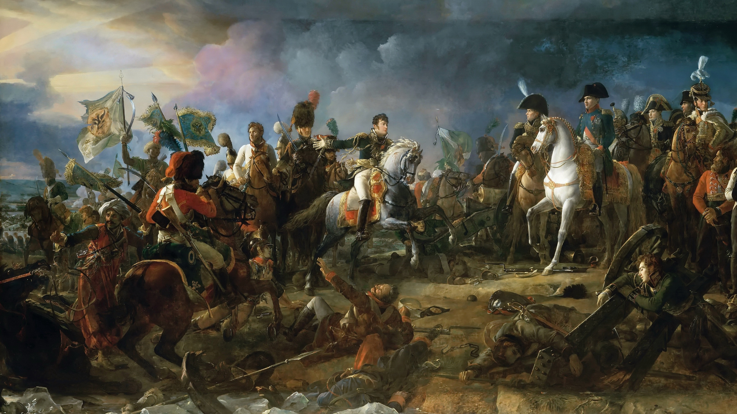
Using napoleons military Deception in IT security.
(also known as CyberDeception)

